Slide 1
VelowUp!®
Smart Bicycle Parking
Manual
Aluminium Profile System
Installation
- Wall
VelowUp!® is a registered product of Lo Minck Systemen BV, Lisserbroek, Holland

Slide 2
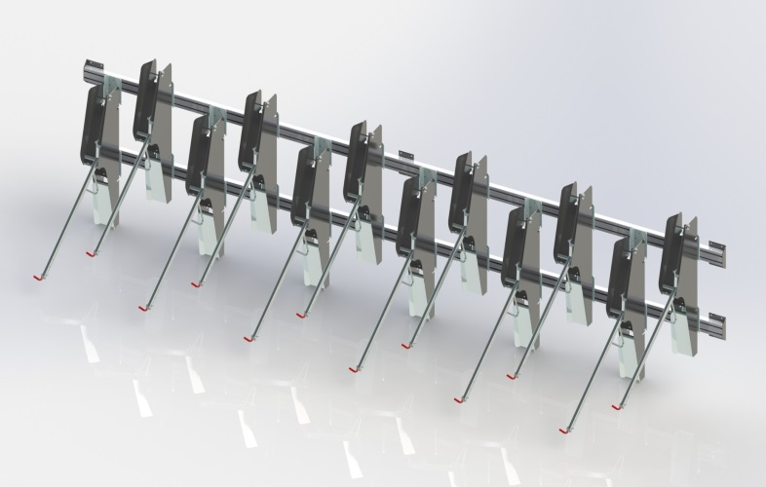
VelowUp!®
Smart Bicycle Parking
Wall
VelowUp!® is a registered product of Lo Minck Systemen BV, Lisserbroek, Holland

Slide 3
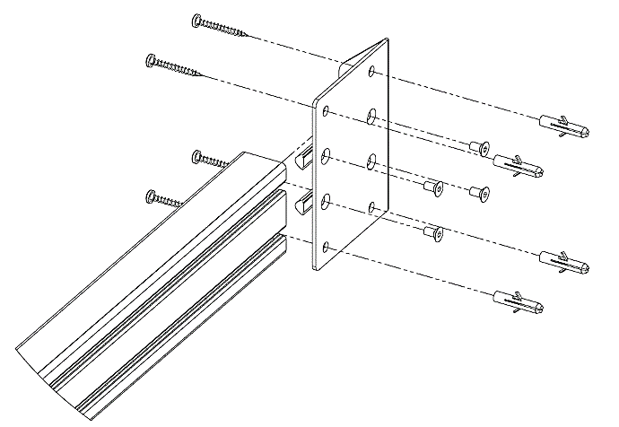
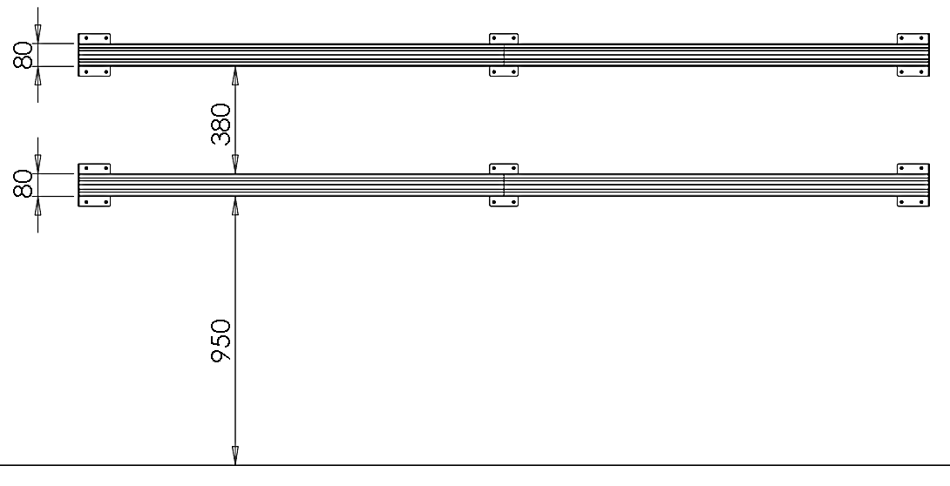
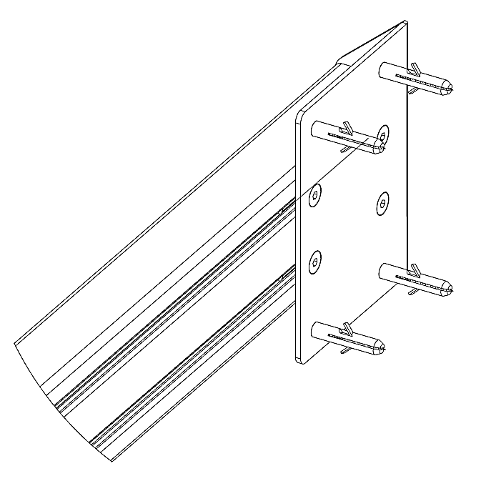
VelowUp!®
Smart Bicycle Parking
Wall installation
Horizontal aluminium bars
Step 1. Place t-nuts into profile channels (4x t-nuts per mounting plate).
Step 2. Connect mounting plates to profile with bolts.
Step 3. Hold profile against wall and mark holes.
Step 4. Drill holes into wall.
Step 5. Insert plugs and screws into wall through mounting plates.
VelowUp!® is a registered product of Lo Minck Systemen BV, Lisserbroek, Holland

Slide 4
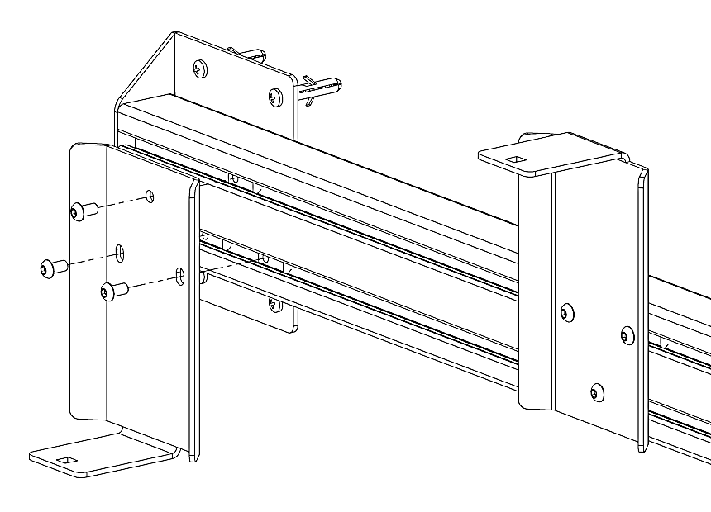
VelowUp!®
Smart Bicycle Parking
Installation VelowUp!®
Aluminium Profile System
Step 1. Place t-nuts into aluminium profile channels (3x t-nuts per mounting plate)
Step 2. Connect mounting plates to profile with bolts
In case the VelowUp!®’s are installed high/low, position mounting plates alternately upwards and downwards
(see above picture)
VelowUp!® is a registered product of Lo Minck Systemen BV, Lisserbroek, Holland

